Slide 1

DSI Capstone Project – EDA & Draft Modelling
Hang (Haden) Liu

Slide 2

Reviewing on Topic & Modelling
Flight records during Jan 2020 in Major US cities
Incl. features: date, time, locations & delay status, etc.
Plan to use classifier models to identify important features on flight delay

Slide 3
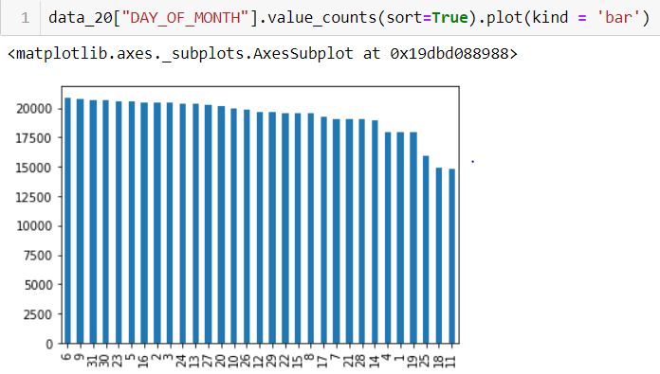
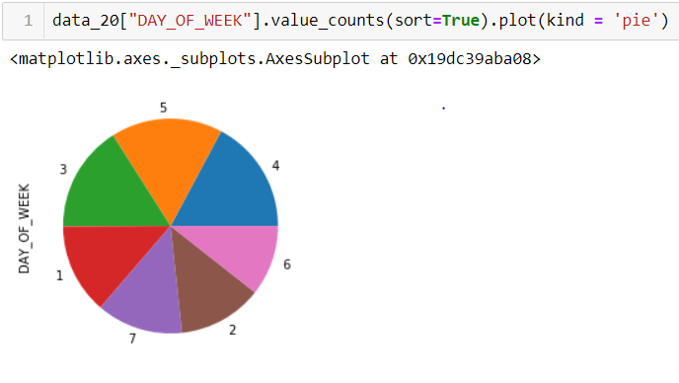
EDA – Time distribution
6th & 9th days of Jan has largest number of delay cases
Thursday and Friday of every week has mode number of delay cases than other weekdays

Slide 4
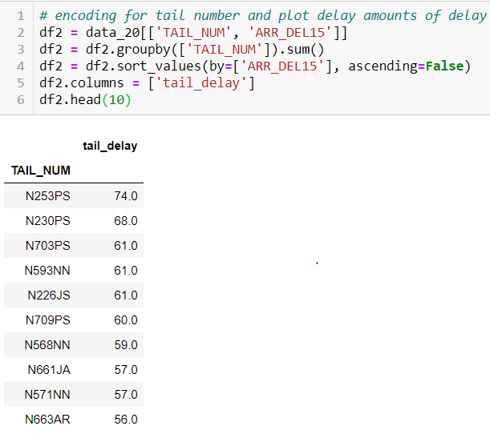
EDA – Flight & Aircraft
Create columns to see the delay amounts for each aircraft during the month

Slide 5
Feature Selection
DAY_OF_MONTH
DAY_OF_WEEK
OP_CARRIER_AIRLINE_ID
OP_CARRIER_FL_NUM
DEP_TIME
DEP_DEL15
ARR_TIME
CANCELLED
DIVERTED
DISTANCE
tail delay
ARR_DEL15

Slide 6
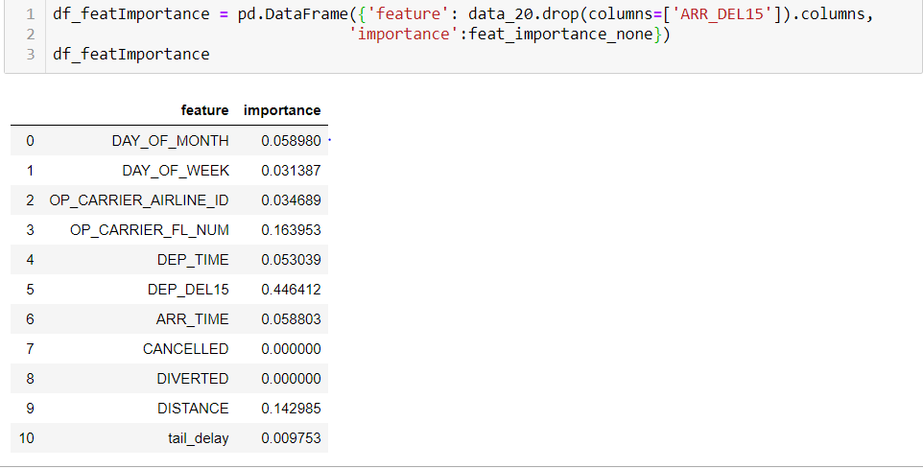
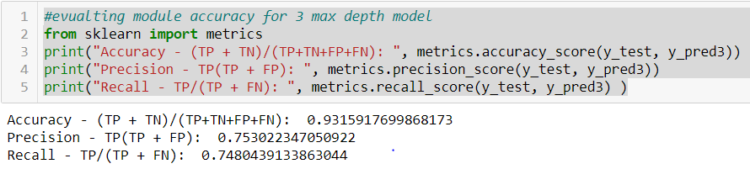
Modelling – Decision Tree
80/20 split to separate the train / test data
Training the models with various max_depth values
Obtained approx. 93% on accuracy with the 3 max_depths model
Obtained approx. 89% on accuracy with the None max_depth model
Use feature importance method to get important features

Slide 7
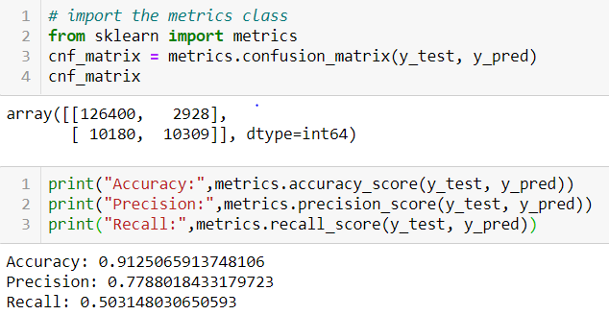
Modelling – Logistics Regression
Same rules on train/test splitting and feature selection with Decision Tree
Obtained approx. 91% accuracy based on selected features
Tried 2 methods for feature importance selection
1. RFE Model ( run with error )

Slide 8
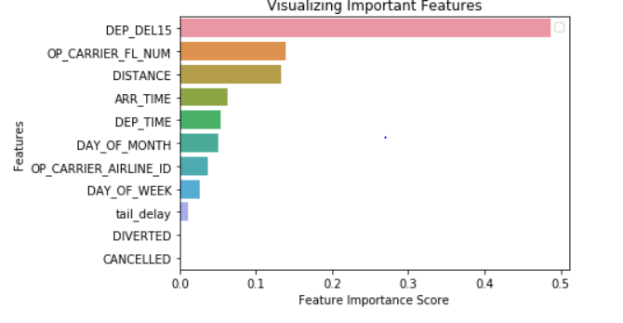
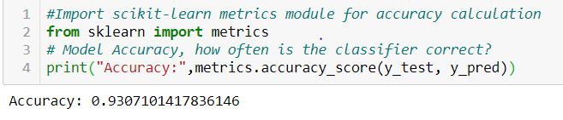
Modelling – Random Forest
Same rules on train/test splitting and feature selection with Decision Tree
The Model obtained approx. 93% accuracy based on current selected features
Obtained feature importance with feature_importances_ method

Slide 9
Next Steps
feature Engineering
Scraping weather data from external sources

